Slide 1
Twitter Sentiment Analysis
Group 10
Dishant Koli (1002067615)
Arnav Sharma(1002070507)
Chandishwar Goud Anthati (1002066835)
Akshata Agine (1002065578)
Professor - Yingying Zhu

Slide 2
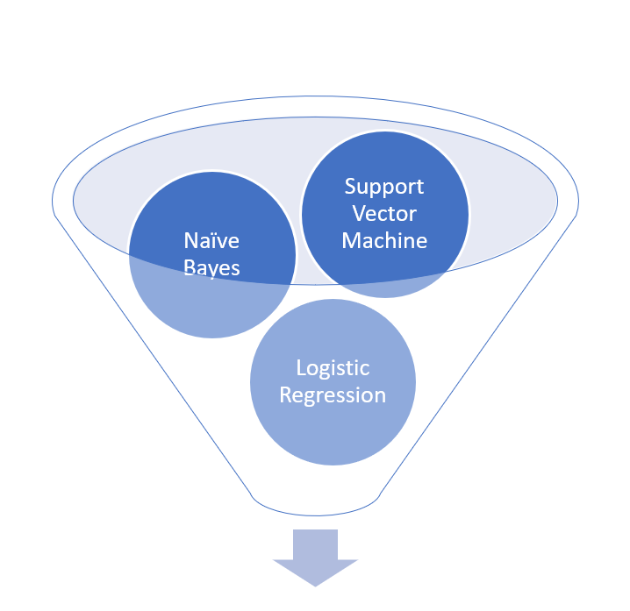
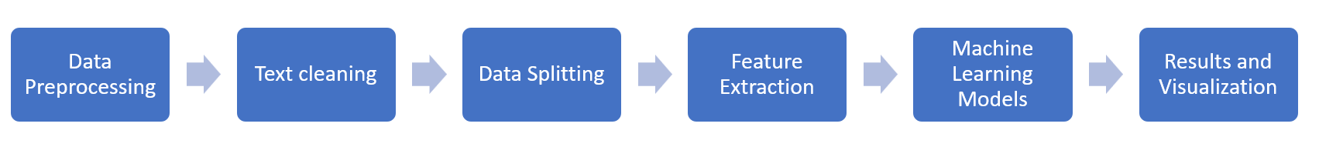
Introduction

Slide 3

Twitter Sentiment Analysis
Definition
Twitter Sentiment Analysis involves the use of natural language processing, machine learning, and statistical techniques to evaluate and determine the sentiment expressed in tweets. The primary goal is to understand whether a tweet conveys a positive, negative, or neutral sentiment.
Importance
Understanding Public Opinion
Brand Monitoring
Customer Feedback Analysis
Crisis Management
Risk Management

Slide 4
Challenges
Overcoming challenges in our project involved:
Data Quality: Navigating the complexity of preprocessing noisy social media text, including slang and irregular formats.
Feature Selection: Fine-tuning Tf-idf vectorization for optimal text data representation.
Model Tuning: Carefully adjusting SVM parameters and implementing 10-fold cross-validation to prevent overfitting.
Imbalanced Data: Addressing sentiment class imbalances in training datasets.
Result Interpretation: Accurately interpreting metrics like precision, recall, and F-measure for meaningful insights.
Comparative Analysis: Assessing SVM's performance across varied datasets and benchmarks.
Computational Resources: Efficiently managing large datasets and the intensive computational requirements of machine learning models.

Slide 5
Previous Work
In the domain of Twitter sentiment analysis, two studies demonstrated the effectiveness of machine learning algorithms. The first study utilized SVM and K-NN classifiers and found that SVM had better performance, with an accuracy of 74.46% and a recall rate of 70.80%. The second study explored the application of Naive Bayes, SVM, and Logistic Regression on an Indonesian Twitter dataset. It highlighted that each algorithm had its strengths, with an overall accuracy of 75% and an F1-score of 77%, suggesting a good balance of precision and recall across the methods used. These findings contribute valuable insights into the field of sentiment analysis, particularly in terms of algorithm efficiency and accuracy in different cultural and linguistic contexts.

Slide 6
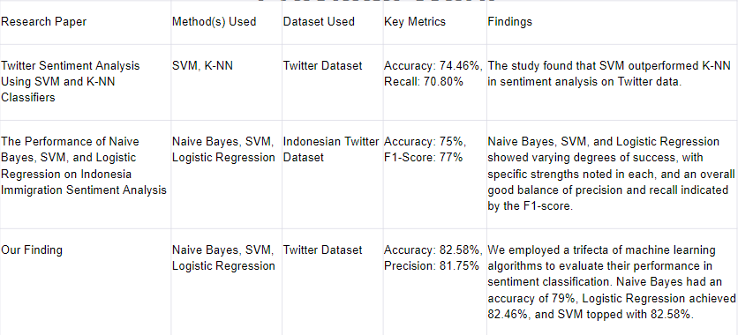
Previous Work

Slide 7
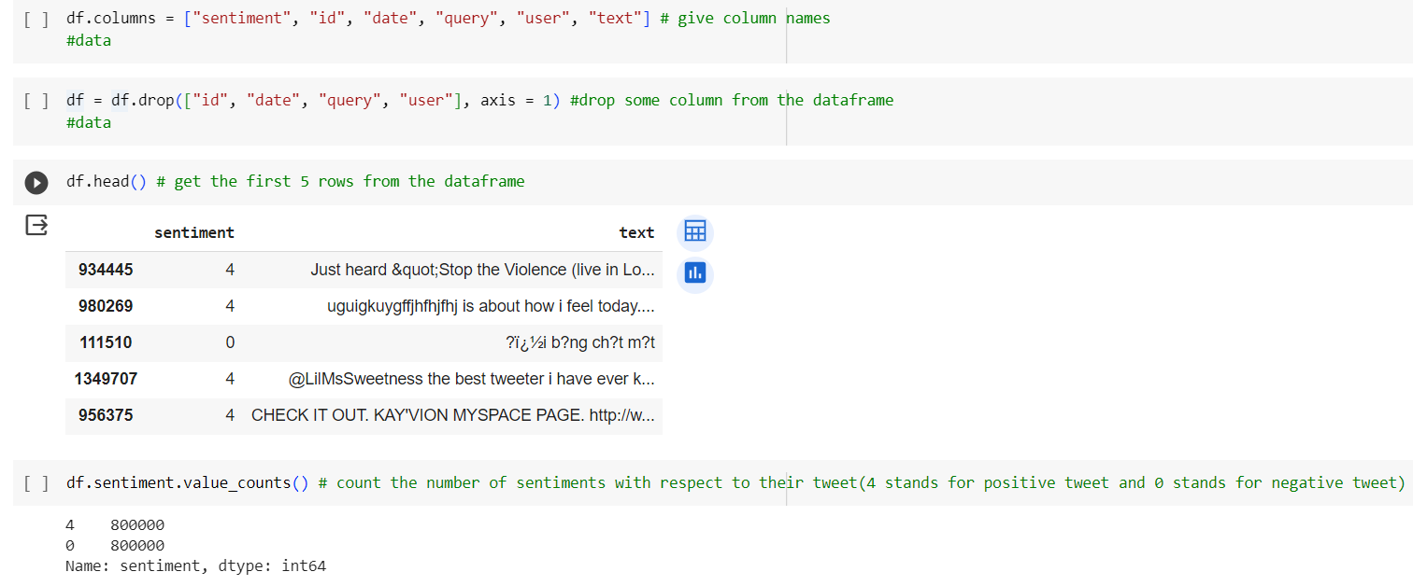
Dataset
Overview
The dataset comprises 1.6 million tweets annotated for sentiment analysis.
It includes three sentiment labels: 0 (negative), 2 (neutral), and 4 (positive).
Dataset Details
target: Polarity of the tweet (0 = negative, 2 = neutral, 4 = positive).
ids: Unique identifier for each tweet (e.g., 2087).
date: Timestamp of the tweet creation (e.g., Sat May 16 23:58:44 UTC 2009).
flag: The query associated with the tweet; "NO_QUERY" if none.
user: Twitter handle of the user who tweeted (e.g., robotickilldozr).
text: The actual content of the tweet (e.g., "Lyx is cool").
Data Annotation
Sentiment labels are assigned based on emoticons, with positive emoticons (e.g., :) ) indicating positive sentiment and negative emoticons (e.g., :( ) indicating negative sentiment.
Dataset Link: Twitter Sentiment Analysis Dataset
Generation Approach
The training data was automatically created using the Twitter Search API with keyword searches for positive and negative emoticons
.
Unique Approach
The dataset's uniqueness lies in the automatic creation of training data, assuming positive sentiment for tweets with positive emoticons and negative sentiment for tweets with negative emoticons.
This dataset not only provides a rich resource for sentiment analysis but also showcases an innovative approach to training data generation, emphasizing the significance of emoticons in determining sentiment.

Slide 8
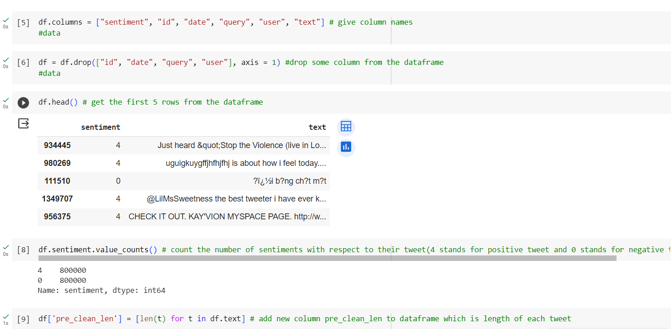
Data Preprocessing
Load and inspect data
Column selection
Sentiment distribution
Add new column
Text cleaning
Text Cleaning involves converting contractions (isn’t - is not), removing URLs, converting to lowercase, removing special characters and stop words

Slide 9
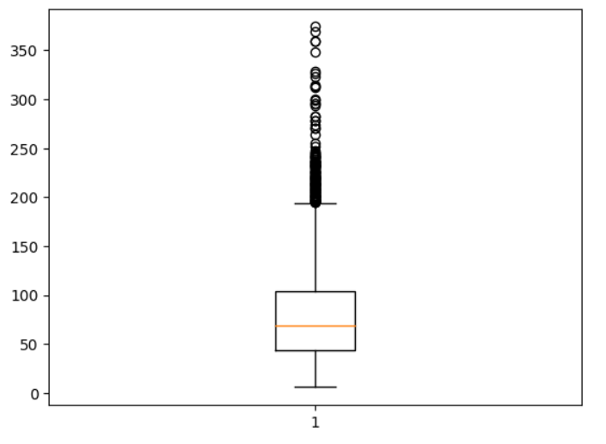
Graph Interpretation - Pre-cleaning
The box plot indicates that most tweets fall within a moderate length range, with a typical distribution between 40 and 100 characters.
The median at 75 characters suggests that the central tendency of tweet lengths is around this value.
The presence of outliers beyond 200 characters, with four tweets even exceeding 320 characters, highlights the existence of longer tweets that significantly deviate from the typical length distribution.
The concentration of outliers in the higher range (200-250 and above 320) may indicate right-skewness, suggesting a dataset with a longer tail on the right side.
Longer tweets might contain more detailed information or express more complex sentiments.

Slide 10
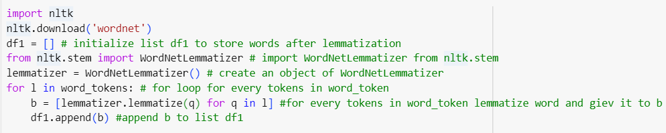
Lemmatization
Lemmatization is a valuable technique in Twitter Sentiment Analysis, focusing on reducing words to their base or dictionary form.
Purpose of Lemmatization:
Precise Normalization: Lemmatization provides a more precise normalization compared to stemming by considering the context and meaning of words.
Code Implementation:
Handling Contextual Variations:
Retaining Meaning: Lemmatization considers the context in which words appear, retaining their original meanings.
Example: Lemmatizing "better" results in "good," capturing the intended sentiment more accurately.
Adaptability to Twitter Language:
Handling Abbreviations: In the context of Twitter, where abbreviations and informal language are prevalent, lemmatization aids in preserving the intended sentiments of users.

Slide 11
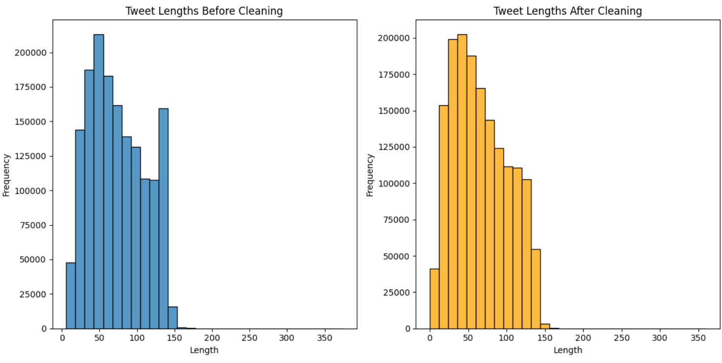
A notable observation from the histogram is the substantial cluster of noise, with a frequency ranging from 10,000 to 17,000 tweets, all having a length of 140 characters. This concentrated grouping may indicate a commonality among these tweets, potentially involving URLs or extra spaces. However, as part of the cleaning process, this noise was effectively removed. The elimination of this chunk contributes to refining the dataset by addressing potential outliers, ensuring a more accurate and meaningful analysis of the underlying sentiment in the remaining cleaned tweets.

Slide 12
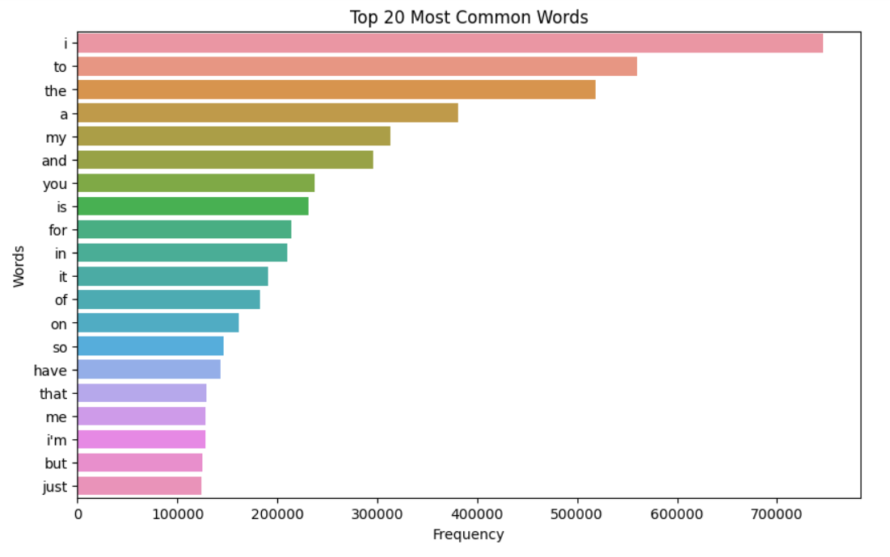
The graph highlights "i" as the most frequently used word, suggesting its prevalence in the dataset. Conversely, words like "that," "me," "im," and "but" appear with lower frequencies, indicating their infrequent usage.
This pattern could be indicative of certain language tendencies. For instance, the prevalence of prepositions such as "for", “in” and "on" in the middle range of the frequency spectrum may suggest a tendency towards neutral sentiments.
The observation that "i" is the most used word implies that self-expression or personal statements might play a significant role in the dataset.

Slide 13
Testing the data using 3 approaches
NAIVE BAYES
LOGISTIC REGRESSION
SUPPORT VECTOR MACHINE
Naive Bayes is well-suited for Twitter Sentiment Analysis due to its efficiency with text data, probabilistic framework, assumption of conditional independence, and robustness to noisy data.
Its fast training time, good performance in binary classification, and ability to handle high-dimensional data make it suitable for sentiment analysis on the dynamic and noisy Twitter platform.
The algorithm's interpretability and Laplace smoothing for unseen words further contribute to its effectiveness, providing a solid choice for quick and reliable sentiment predictions in the realm of social media analysis.
Logistic Regression is well-suited for Twitter Sentiment Analysis due to its versatility and simplicity.
It effectively handles binary classification tasks, making it suitable for distinguishing between positive and negative sentiments in tweets. Its ability to model complex relationships and interpretability is valuable for understanding the impact of different features on sentiment prediction.
Logistic Regression is computationally efficient, making it practical for large-scale Twitter datasets.
Support Vector Machine (SVM) is a robust algorithm for Twitter Sentiment Analysis due to its ability to handle high-dimensional data and capture complex relationships within the data. SVM excels in finding optimal decision boundaries, making it effective in separating sentiments in tweets that may have non-linear patterns.
Its versatility in handling both linear and non-linear relationships provides an advantage in the varied and dynamic nature of Twitter language.

Slide 14
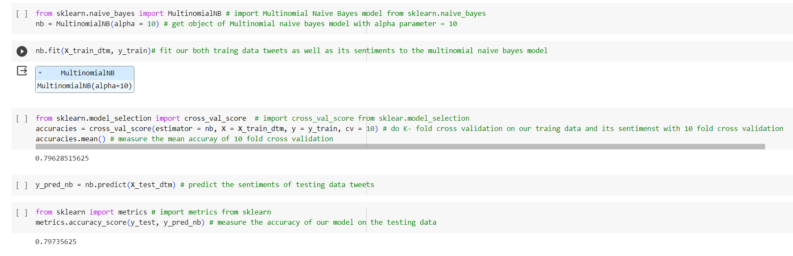
Naive Bayes
This code snippet demonstrates the complete process of training a Multinomial Naive Bayes model for sentiment analysis using a specified alpha parameter, performing K-fold cross-validation to assess its generalization performance, and predicting sentiments for the testing data.
The resulting mean accuracy provides insights into how well the model is expected to perform on unseen data. The predictions (y_pred_nb) can be further evaluated against the true sentiments to assess the model's effectiveness in sentiment classification.

Slide 15
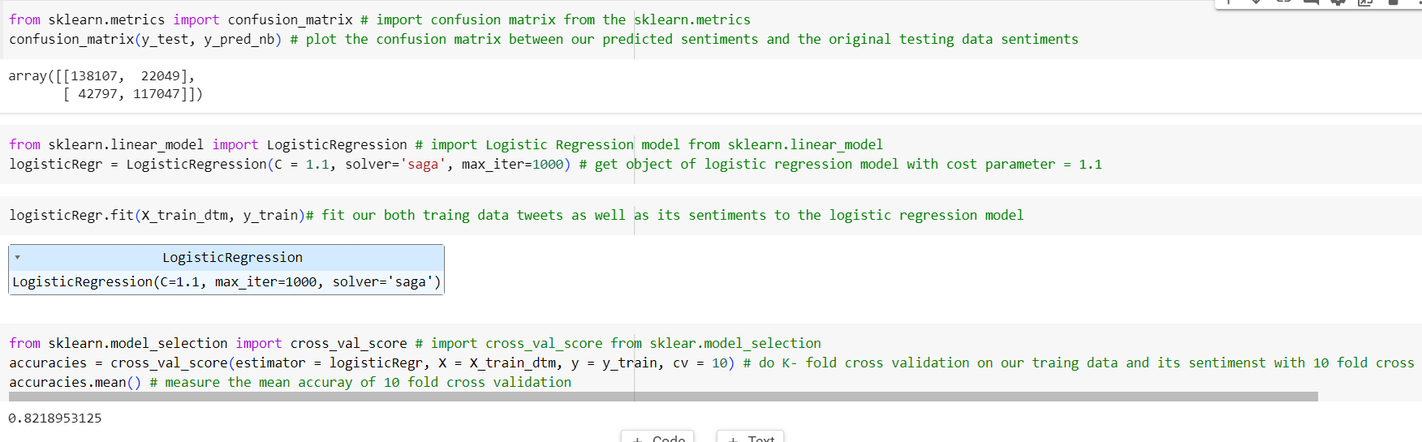
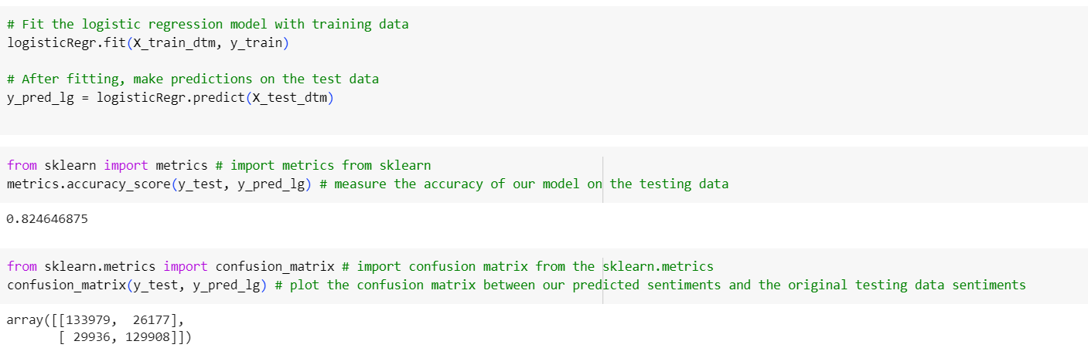
Logistic Regression
With 138,107 true negatives (TN) and 117,047 true positives (TP), the model demonstrates proficiency in correctly classifying both negative and positive sentiments. However, 22,049 false positives (FP) and 42,797 false negatives (FN) indicate a moderate level of misclassifications.
The Logistic Regression model's performance on the training set reveals a similarly balanced outcome. The confusion matrix shows 133,979 TN and 129,908 TP, indicating strong accuracy in predicting both negative and positive sentiments.
The initial accuracy of 82.18% improves slightly to 82.46% after training, affirming the model's robustness and its ability to maintain consistent performance on both training and testing datasets.
Acc - 82

Slide 16
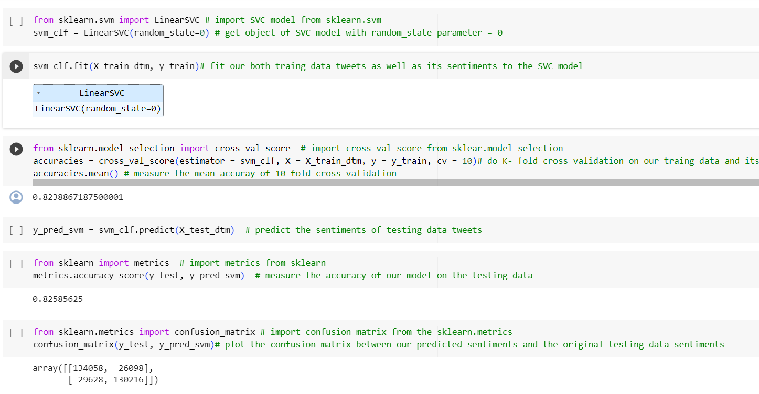
Support Vector Machine
The Support Vector Machine (SVM) model initially exhibited an accuracy of 82.36% on the testing set.
Following training, the model's accuracy experienced a notable increase to 82.58%, indicating an improvement in predictive capabilities.
The 10-fold cross-validation results, represented by the confusion matrix, reveal a robust performance with 134,058 true negatives (TN) and 130,216 true positives (TP).
The model demonstrated proficiency in correctly classifying both negative and positive sentiments, while 26,098 false positives (FP) and 29,628 false negatives (FN) indicate a moderate level of misclassifications.
The cross-validation process reinforces the model's stability and consistency across diverse subsets of the training data, affirming its reliability in handling the nuances of Twitter sentiment analysis.

Slide 17
Future Work
Including pictures and emojis in Twitter Sentiment Analysis makes it better at understanding how people feel. When we look at the actual images people share, the analysis can pick up on the extra emotions and details that text might miss. Emojis, those little smiley faces and symbols, also give a quick way for people to show how they're feeling. By considering both text and visuals, sentiment analysis can be more tuned in to the different ways people express their emotions online. It's like getting the full picture of what people mean, and it helps make sentiment analysis more accurate and aware of different cultures on social media. It can be done by employing CNN. This mix of words, images, and emojis is a promising way to really get what people are saying and feeling in the ever-changing world of social media.

Slide 18
References
https://ieeexplore.ieee.org/document/8609670/citations#citations
https://www.ncbi.nlm.nih.gov/pmc/articles/PMC9554374/
https://www.researchgate.net/profile/Shabib-Aftab-2/publication/321084834_Sentiment_Analysis_of_Tweets_using_SVM/links/5a1497b90f7e9b925cd514b0/Sentiment-Analysis-of-Tweets-using-SVM.pdf
https://www.kaggle.com/datasets/kazanova/sentiment140
https://www.researchgate.net/publication/328935798_Twitter_Sentiment_Analysis_Using_Support_Vector_Machine_and_K-NN_Classifiers#:~:text=Twitter%20Sentiment%20Analysis%20Using%20Support,DigTech%20ASEAN%20Figures%20Discover%20the
https://www.researchgate.net/publication/376120096_The_performance_of_Naive_Bayes_support_vector_machine_and_logistic_regression_on_Indonesia_immigration_sentiment_analysis#:~:text=In%20this%20paper%2C%20we%20have,NB%29%2C%20support%20vector

